Slide 1
Fractal Intelligence Engine
Market intelligence
across horizons
A research perspective on the structure behind price
Experimental product preview • September 2026
Notes:
An actively developed experimental market-research application. Synthetic demo only. No investment-performance claim.

Slide 2
A single timeframe leaves context out
Selected window
Missing context
The same price movement can look different across observation windows.
A confident summary can hide disagreement, changing volatility, or missing inputs.
FRACTAL INTELLIGENCE / 02
Notes:
Conventional indicators can be useful. Every observation window omits information. No comparative performance claim.

Slide 3
Participants do not share one clock
Tactical
Swing
Structural
1–3 intended holding days
Hourly source bars
7 / 14 / 28-day lookbacks
3–15 intended holding days
Daily source bars
30 / 90 / 180-day lookbacks
15–60 intended holding days
Daily source bars
180 / 365 / 730-day lookbacks
FRACTAL INTELLIGENCE / 03
Notes:
Actual horizon definitions: source docs/horizon-regime-v1.md. Intended holding horizons differ from calculation lookbacks. FMH inspiration: Edgar E. Peters, Fractal Market Analysis, Wiley, 1994. No affiliation.

Slide 4
Evidence remains attached to the result
Retain observations
Freeze the fit
Preserve limitations
Preserve source identity, input history, and when information became known.
Compute declared features and retain training thresholds before evaluation.
Keep missing inputs and disabled qualification flags visible in the result.
FRACTAL INTELLIGENCE / 04
Notes:
Source: docs/horizon-regime-v1.md and docs/feature-registry.md. Marketing site has no engine connection.

Slide 5
An inspectable research workflow
Market behavior
Evidence history
Quote context
Multi-horizon diagnostics and experimental fractal estimators.
Retained feature records with input cutoffs and calculation lineage.
Spread, retained depth, cross-venue comparison, and bounded sampling.
FRACTAL INTELLIGENCE / 05
Notes:
Implemented scope reviewed September 6, 2026. Source: docs/development-status.md. Research code does not establish commercial qualification.

Slide 6
Descriptors with explicit limits
Implemented diagnostics
Proposed intelligence
Normalized momentum and realized volatility describe selected windows. R/S and DFA remain experimental.
FMSI, composite Risk, and Opportunity scores require formulas, qualified inputs, and validation.
FRACTAL INTELLIGENCE / 06
Notes:
Source: docs/experimental-fmh.md; RegimeContract.cs. HurstInterpretationAllowed, AnalyticalUseAllowed and RecommendationsEnabled remain false. No fractal dimension emitted.

Slide 7
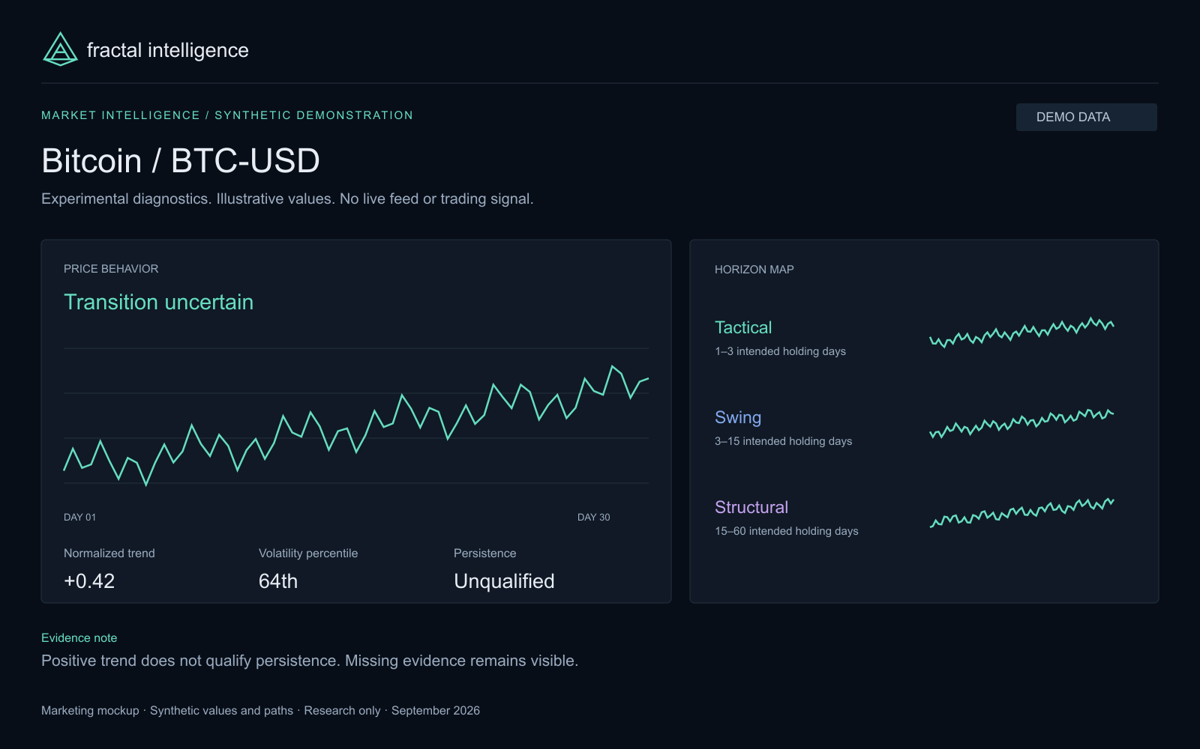
Uncertainty is part of the view
FRACTAL INTELLIGENCE / 07
Notes:
DEMO DATA. Synthetic BTC values: trend +0.42, volatility percentile 64th, TransitionUncertain. Not actual engine results or current observations.

Slide 8
Independent research first
Initial audience
Future conversations
Serious individual investors and quantitative researchers seeking clearer market context.
Adviser, developer, and institutional workflows help define reporting and data requirements.
FRACTAL INTELLIGENCE / 08
Notes:
Initial audience hierarchy from the brief. Adviser and institutional workflows are prospective. No customer counts or existing enterprise contracts are claimed.

Slide 9
Proposed plans, open questions
Explorer / Pro / Quant / Professional
Final pricing depends on qualified coverage, data rights, support needs, and operating costs.
Prices and launch timing are unannounced.
FRACTAL INTELLIGENCE / 09
Notes:
No subscriptions currently for sale. No commercial entitlements or prices committed. See lib/pricing.ts and docs/strategy.md.

Slide 10
A focused interpretation layer
Existing platforms
FI’s intended focus
Glassnode: digital-asset metrics
Koyfin: broad market workflows
QuantConnect: research infrastructure
Understandable horizon context combined with retained evidence and explicit uncertainty.
FRACTAL INTELLIGENCE / 10
Notes:
Sources reviewed September 6, 2026: https://studio.glassnode.com/pricing ; https://www.koyfin.com/pricing/ ; https://www.quantconnect.com/pricing/ ; https://regimeanalytics.com/ . No exclusivity or performance superiority claim.

Slide 11
Qualification precedes broader availability
Research requirements
Proposed commercial work
Qualified persistence and liquidity context. Combined acceptance and performance validation.
Public APIs, composite scores, broader coverage, and reporting.
FRACTAL INTELLIGENCE / 11
Notes:
Source: docs/development-status.md. No dates committed. Commercial roadmap is proposed.

Slide 12
Bring your market questions
Explore the synthetic demo.
Read the methodology.
Register your research interests.
fractal-intelligence-engine.flxc4p4str.chatgpt.site/early-access
FRACTAL INTELLIGENCE / 12
Notes:
No payment required to register interest. Beta invitations and timing are unannounced. CTA https://fractal-intelligence-engine.flxc4p4str.chatgpt.site/early-access

